Slide 1
Analyzing Health Equity Using Household Survey Data
Lecture 6
Measurement of Living Standards
Notes:
In previous lectures we examined measurement of alternative health outcome variables of interest. We now turn to measurement of the characteristic against which the distribution of health is to be examined – living standards.

Slide 2
Living standards and socioeconomic status
Our concern: socioeconomic disparities in health
Could examine health in relation to:
  Categorical indicator of socioeconomic status (SES): education, occupation,
  Continuous measure of living standards: income, consumption, wealth
Each may be of intrinsic interest, but here concentrate on latter because:
  Measures of inequality employed require ranking, preferably uniquely 1,….n
  We are economists!
Which measure of living standards and does it matter for estimation of economic-related health inequality?

Slide 3
Flow and stock concepts
Flow variables
Income
  The amount that can be consumed in a given period without reducing the stock of wealth
Expenditure
  The amount paid by household for food, clothing, household durables, loan repayments
Consumption
  The amount of resources actually used (consumed) during a given period
Stock variable
Wealth
  Total value of assets and liabilities at any point in time
Notes:
Flow variables represents quantities of resources that either come in to or go out of the household during a given period of time.
A stock is a quantity the household has at a given point in time.
Note that income is expressed in terms of potential consumption that could be realised without drawing on wealth. This is the Haig-Simons definition of income. This potential consumption is determined by the total, not only labour, earnings of the household, including transfers, plus the value of home production. Income is less accurate than consumption as a measure of long-term living standards since earnings may temporarily rise or fall during a period, but if a household consumes according to their life-time or permanent income, then consumption and living standards will not vary by as much.
Expenditure is the outlay on market traded goods and services. It is a less comprehensive measure of living standards than consumption and income since it does not cover consumption from household production. It is also a less accurate measure of long-term living standards since expenditures on durable items in any one period will temporarily raise expenditure but not living standards.
Consumption includes both market and home produced goods. Both because it covers home production and because, according to life-cycle theory, if varies with permanent income, it is considered the most preferred measure of living standards.
Wealth is a determinant of living standards but it does not reflect the consumption actually experienced.

Slide 4
The relationship between measures of living standards
Income ≠ Consumption
  Saving and borrowing drives wedge between concepts
  Tendency to smooth consumption over time
Consumption ≠ Expenditure
  Expenditure excludes non-market transactions
  Durables: use value may be different from expenditure
Wealth ↔ Income ↔ Consumption
  Motives for wealth accumulation: life-cycle considerations and precautionary
Notes:
See notes to previous slide.
In the absence of full private or social insurance against, for example, health risks, wealth may be held for precautionary motives. Then wealth may not be a good measure of living standards. Rather it may reflect differences in levels of insurance cover between households. The uninsured household may hold more wealth but does not enjoy a higher standard of living as a result.

Slide 5
Relationship between income and consumption
SAVING
BORROWING
INCOME
TAXES & TRANSFERS
USE VALUE OF DURABLES
CONSUMPTION
EXPENDITURE
IN-KIND RESOURCES
“IMMEDIATE” CONSUMPTION
IMPERFECT MEASUREMENT
IMPERFECT MEASUREMENT
Notes:
Measured income often diverges substantially from measured consumption. In part, this is due to conceptual differences in the respective terms—it is possible to save from income and to finance consumption from borrowing. Moreover, although this is not inherent in the definition of income, income surveys often exclude household production. There is a long-standing and vigorous debate about which is the better measure of standards of living. For developing countries, a strong case can be made for preferring consumption, based on both conceptual and practical considerations (Deaton and Grosh 2000).
Income is received only intermittently, whereas consumption can be “smoothed” over time. As a consequence, it is reasonable to expect that consumption will be more directly related to current living standards than will current income, at least for short reference periods. In other words, although the flow of consumption over a period of, say, a week or a month, may provide a good indication of the level of consumption during a full year, measured income over the same period is most likely an inaccurate measure of income for a full year.
Income and expenditure data are both difficult to collect. In developed countries, in which a large proportion of the population works in the formal sector and in which consumption patterns are very complex, the balance often tips in favor of measuring income rather than consumption. Even so, these surveys often have considerable problems dealing with self-employment, informal economic activities, and widespread reluctance to disclose information on income to survey enumerators. In developing countries, formal employment is less common, many households have multiple and continually changing sources of income, and home production is more widespread. In these contexts, it is generally far easier to measure consumption than income.

Slide 6
Approaches to measurement
 | Direct measure | Proxy measure
Income | Questionnaire modules in survey | Predicted consumption / income from asset variables and other HH characteristics
Consumption
Wealth |  | Asset index (ad hoc, principal component, or factor analysis)
Notes:
Direct measures, such as income, expenditure, or consumption can be recorded in a questionnaire. This generally provides most information on living standards but it can be very expensive and requires diligent response from the interviewees. Detailed consumption modules are usually included in household budget surveys. Detailed income and wealth modules are included in economic surveys, including those focusing on poverty and retirement. Such detailed modules are seldom available in health interview surveys. These might ask for income or expenditure in broad categories.
Proxy measures attempt to make the best use of the limited data available. The first approach identified above involves using the relationships between consumption/income and covariates such as age, region, education estimated from a dataset that has both to predict consumption/income in a dataset that only has the covariates (and a measure of health).
The second approach to proxy measurement involves weighting different assets that are presumed to either be an indicator or a determinant of living standards, such as ownership of durables, car, housing materials, etc.
The weights may be entirely subjective, or ad hoc, being chosen by the researcher.
Alternatively a statistical data reduction method, such as principal components or factor analysis, may be used to derive the weights.

Slide 7
Measuring income and wealth
Income
  Many components: cash earnings, other cash market income (interest, dividends, etc.), cash transfers, other money income, realized capital gains and intermittent income, in-kind earnings and home production, imputed rent for owner-occupied dwellings,…
Wealth
  Financial and non-financial assets and liabilities
Data collection is tricky…
  Non-response and reporting bias
  Respondents may not know value of assets
  Comprehensiveness of measure
Income and wealth data rarely collected directly in HH surveys in developing countries
Notes:
Broadly speaking, income is composed of earnings from productive activities and transfers. It is customary to distinguish four main components in the measurement of income: (i) wage income from labor services; (ii) rental income from the supply of land, capital, or other assets; (iii) self-employment income; and (iv) current transfers from government or non-government agencies or other households.
Many attempts to measure income have not considered home production, although this can be conceived as a form of income. In cases in which home production is considered, practical considerations often limit the scope. For example, some income measures seek to include subsistence agricultural production in the calculation of household income. In contrast, “service activities” such as child minding performed in the household are generally excluded. For home-produced goods that are either exchanged by barter or consumed directly in the household, and for any income received in-kind, values have to be imputed.
Although some surveys in developing countries—for example, in Latin America—have collected detailed income data, attention is often restricted to employment income. That is the case, for example, in most Living Standards Measurement Study (LSMS) surveys. Moreover, the quality of the data has often been poor. As a consequence, income data from these surveys have rarely been used as a proxy for living standards..

Slide 8
Measuring consumption
Two approaches to measuring consumption
  Retrospective recall questions about consumption
  Diary recording of consumption and expenditure on daily basis (literacy issue)
  Either approach normally requires multiple visits to households
Data collected on
  Food and non-food items, durables, and housing
  Purchased and home-produced items
  Considerable variation across surveys in number of items covered
Consumption is measured with respect to a reference period e.g, one year
Recall periods (time interval for which consumption reported) varies across goods and services depending on frequency of purchase
Notes:
Although the reference period varies, many surveys aim to accurately measure the total consumption of the household in the past year. In this way, temporary drops in consumption are ignored, and it is still possible to capture changes in living standards of a single individual or household over time. In some contexts—for example, where there are important seasonal variations in living standards—it may be appropriate to focus on time periods shorter than a year.
The reference period should be distinguished from the recall period, which refers to the time period for which respondents are asked to report consumption in the survey. Recall periods tend to differ for different types of goods, such that reporting on goods that tend to be purchased infrequently is based on a longer time period. The balance has to be struck between capturing a sufficiently long period so that the consumption during the period is representative of the reference period (year) as a whole and making it sufficiently short such that households can remember expenditures and consumption with reasonable accuracy.

Slide 9
Constructing consumption aggregates
Food consumption
  Purchased food: amount spent in typical month x 12
  Home-produced: qty in typical month x farmgate price x 12
  Received as gift or in-kind payment: total value p.a.
  Consumed outside home: restaurant, at work, at school, etc.
Non-food consumption
  Daily use items, clothing, house-ware (annualized)
  Health spending
Durables & housing
  Durables: rental equivalent value
  Housing: actual or imputed rent (annualized)
Exclude
  work-related expenses; purchases of assets; spending on durables & housing; other lumpy spending; most taxes
Notes:
In general, there are three steps in the construction of a consumption-based living standards measure: (i) construct an aggregate of different components of consumption, (ii) make adjustments for cost of living differences, and (iii) make adjustments for household size and composition.
Consumption of durables refers to the “rental equivalent” or “user cost” of the good. This can be thought of as comprising two components: (i) the opportunity cost of funds tied up in the durable good and (ii) the depreciation of the good. Generally, these values must be imputed. For this reason, most surveys collect data on the stock and characteristics of durables, rather than on expenditures on these items.
Generally, the most important “durable good” is housing. In this case, rental data are sometimes available. For households that do not report rent, a value can be imputed by using the relationship between rent and housing characteristics in the subset of households that report rent (a “hedonic regression”). However, this approach can be tenuous in contexts in which this subset is a small proportion of all households or in which these households are “unrepresentative” in respect to the relationship between paid rent and housing characteristics.
For other household durables, the imputation of values is normally done on the basis of data on date of purchase and cost of acquisition, combined with assumptions about the lifetime of the good. Alternatively, depreciation rates can be calculated using reported “current values.” Procedures are described in detail by Deaton and Zaidi (2002).

Slide 10
Adjusting aggregates…
for cost of living differences
  Spatial and sometimes temporal
for household size and composition –
  In simplest case, per capita consumption
    But does not allow for economies of scale (two can live (nearly) as cheaply as one) and differences in needs
  Construct equivalence scale, E; divide HH consumption by E
  Simple scale: E = (A+αK)^{β}, where A=# adults, K=# kids, and α is child adjustment and β is elasticity capturing economies of scale
  Special cases:
    α=β=1 gives #HH members and is per capita adjustment (no economies of scale)
    α=1; β=0 gives E=1, so equivalent consumption= HH consumption (maximal economies of scale)
    α=1; β=0.75 gives E=(A+K)^{0.75}, this is common—allows limited economies of scale
    α=0.5; β=0.75 gives E=(A+0.5K)^{0.75}, allows for lower consumption needs of kids

Slide 11
Proxy measures of living standards
Collecting and analyzing income, consumption, and wealth data is difficult and expensive
Alternative: construct proxy for living standards using variables that are easier to collect
  E.g. assets, housing characteristics, other individual or HH characteristics
Three approaches to constructing proxy variable
  Predicting consumption (requires both consumption and asset data for at least one survey round)
  Ad hoc (“naïve”) approach - e.g. sum of assets
  Principal component or factor analysis
Notes:
Principal components analysis and factor analysis are essentially tools for summarizing variability among a set of variables.
Principal components analysis seeks to describe the variation of a set of variables as a set of linear combinations of the original variables, in which each consecutive linear combination is derived so as to explain as much as possible of the variation in the original data, while being uncorrelated with other linear combinations.
Typically, the asset index is assumed to be the first principal component—that is, the first linear combination.
Principal components analysis suffers from an underlying lack of theory to motivate either the choice of variables or the appropriateness of the weights.
In contrast to the principal components approach proposed by Filmer and Pritchett (1999), Sahn and Stifel (2000) construct a welfare index on the basis of factor analysis. They argue that factor analysis is preferable to the principal component method because it does not force all of the components to accurately and completely explain the correlation structure between the assets. Despite the perceived advantages, they note that the Spearman rank correlation between the principal components and factor analysis asset indices is about 0.98 for each of the samples considered.

Slide 12
Constructing an asset index
Common variables in asset index
  Durables: bicycle, motorcycle, care, sewing machine, refrigerator, TV, tractor, thrasher, clock, fan, animals, etc.
  Housing: type of floor & roof, type of drinking water and sanitation, type of cooking & lighting fuel, etc.
Construction of index
  Run PCA on index variables
  Retain 1st principal component
  Alternative: factor analysis
What does it mean?
  Statistical methods for combining many variables into a single factor
  New factor is a linear combination of original variables
  Weights assigned to each variable (asset) so as to maximize variation of new variable, subject to number of constraints

Slide 13
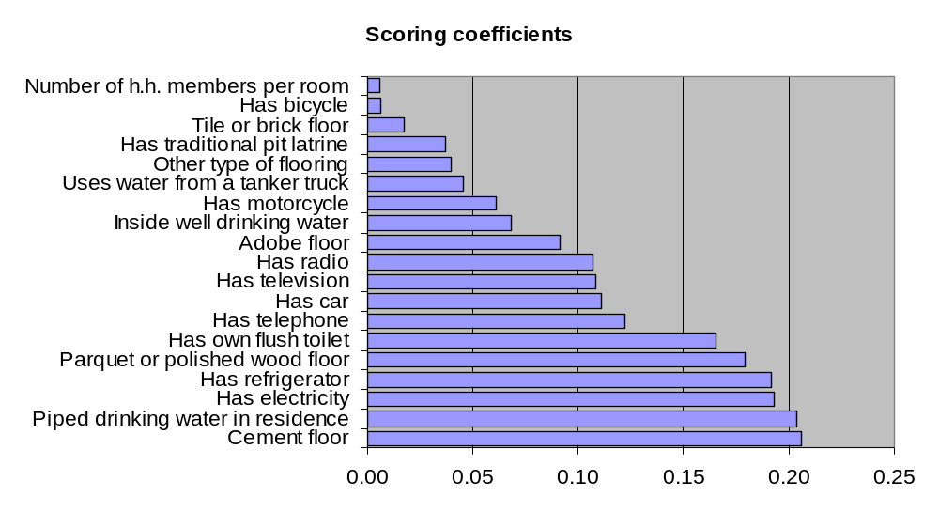
The asset index in Mozambique
Asset index = 0.21 * cement floor + 0.20 * piped drinking water
+ 0.19 * electricity + 0.19 * refrigerator + ... and so on…
Where
Notes:
1. Data are from the 1997 Mozambique Living Standards Survey.

Slide 14
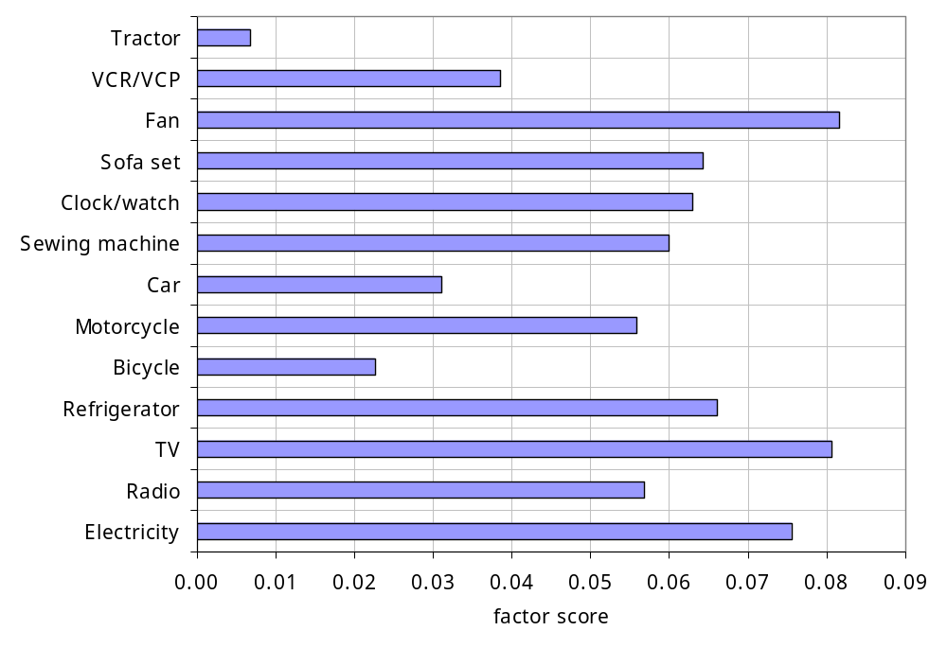
Factor loadings, India 1992-93
Notes:
1. Data are from the 1992-93 Indian National Sample Survey.

Slide 15
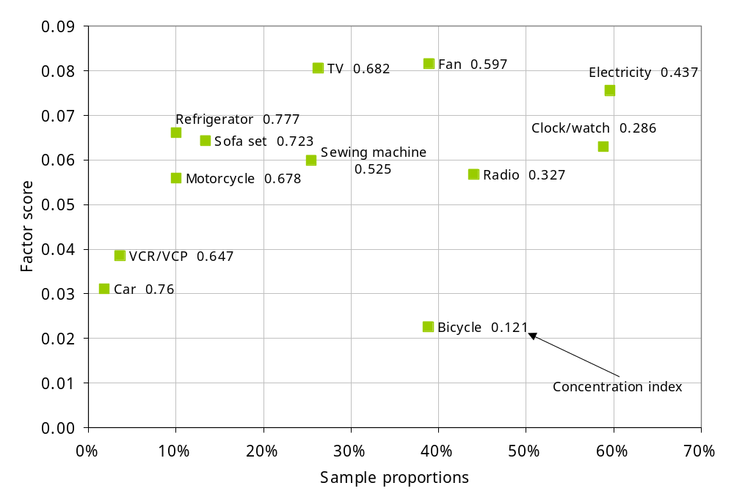
What drives factor loadings?
Notes:
Keep in mind that PCA weights the variables in order to maximise the variance of the composite index.
Since all of the variables in this analysis are dichotomous, the variance of each variable is maxmised when the sample proportion is 0.5 and it declines monotonically as the proportion falls to zero or rises to 1. Hence, we would expect more weight to be placed on variables that have a sample proportion closer to 0.5 and less weight on those close to 0 or 1. Compare Fan and TV with Car and VCR.
But the variance of the composite index will also be larger the greater is the correlation between its components. If households that possess one item are also more likely to possess another, then weighting both of these items highly will increase the variance of the index. On the other hand, if households that have a TV tend not to have a pig and vice versa, then weighting both items equally highly would result in a composite index with little variation as the effect of the two variables cancel out.
This is the basis of the logic for expecting PCA to produce an index that proxies household living standards, or wealth. It identifies variables that move together and so are presume to represent the same underlying factor.
In the diagram, the concentration index is given nest to the name of each variable. The concentration index will be studied in lecture 8 but for now note that as the value approaches 1 it indicates greater pro-rich inequality in the distribution of the variable.
Note that all variables included in this first principal component have a positive concentration index, indicating that they are all distributed in favour of the better-off. All these assets seem to positively indicate wealth and so the composite index may represent that underlying factor.
Note that bicycle has the smallest weight in the index despite the fact that it has a sample proportion of 40% and so a large variance. This appears to be because it is less closely correlated with the other assets. There is indirect evidence of this from the fact that it has the smallest concentration index. Possession of a bicycle discriminates less well between the rich and poor and is less closely correlated with the other assets. For the latter reason it is given a smaller weight in the index.

Slide 16
Does it matter which measure we use?
Correlation between income and asset index often low
  Ranking of individuals changes depending on choice of living standards measure
If re-ranking is correlated with health variable of interest, this will lead to different estimates of inequality
Some evidence that asset index is a good proxy for consumption and estimates of inequality in child anthropometrics are robust choice b/w them
But not true for all health variables of interest
Notes:
Wagstaff and Watanabe (2003) compare measured inequality in wasting and stunting for 19 countries (based on LSMS data) and find that for most countries the choice between consumption and the asset index as the welfare measure makes little difference to the measured degree of socioeconomic inequality in malnutrition.
But results have also been shown to be sensitive to the choice of assets and household characteristics that are included in the index ( Houweling et al. 2003). Moreover, in some contexts, the choice of welfare indicator can drive conclusions in important ways.

Slide 17
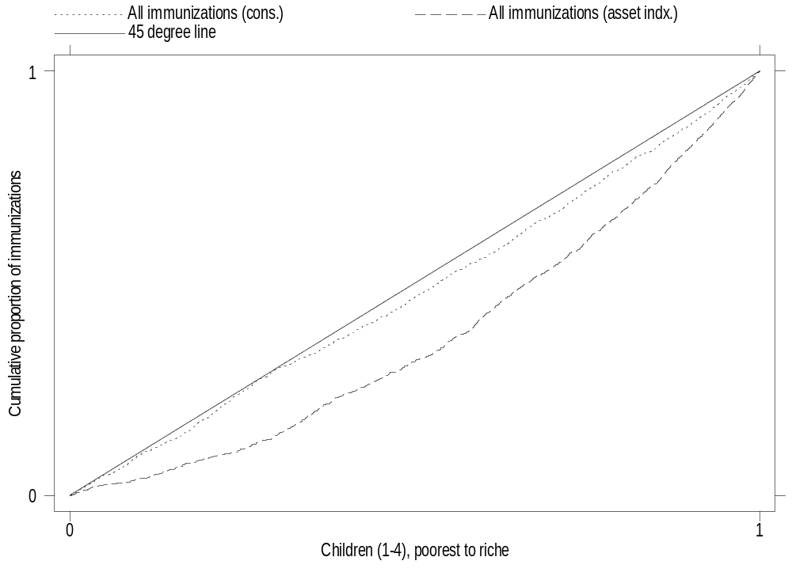
Socioeconomic inequality in immunization in Mozambique
Ranked by asset index
Ranked by consumption
Notes:
Lindelow (2006) finds that the choice of welfare indicator has a large and significant impact on socioeconomic inequalities in service use and on the incidence of public spending in Mozambique.
The diagram shows concentration curves for child immunizations drawn against children ranked by household consumption and an assets index. The further the curve lies below the diagonal, the larger the pro-rich inequality in the distribution of immunizations.
Ranking by the assets index shows greater pro-rich inequality.
For most health services, this study found less inequality in utilization when consumption rather than the assets index was used as the living standards measure. For example, although the poorest quintile ranked by the assets index received only 9.6 percent of all child immunizations, the poorest quintile ranked by consumption received 21.4 percent. For health center visits, inequality moved in the opposite direction—there was inequality favoring the poor using the assets index as the living standards measure but inequality favoring the rich using consumption.

Slide 18
Some conclusions
Be aware of data limitations
Make limitations explicit in analysis
Check sensitivity of analysis if possible
  Choice of living standards measure
  Choice of assets in index
Work towards better data
  Improve measurement of living standards in health surveys (e.g. DHS)
  Improve health data in living standards and household budget surveys

Slide 19
Useful resources
Guide to HH survey methodology
  http://unstats.un.org/unsd/HHsurveys/
World Bank LSMS website
  http://www.worldbank.org/lsms
Deaton and Zaidi paper on consumption aggregation
  http://www.wws.princeton.edu/~rpds/

